Slide 1
Detection of Lung Cancer using Segmentation from CT Images
MSCSF19M020 Celal Ahmed
MSCSF19M029 Abubakar

Slide 2
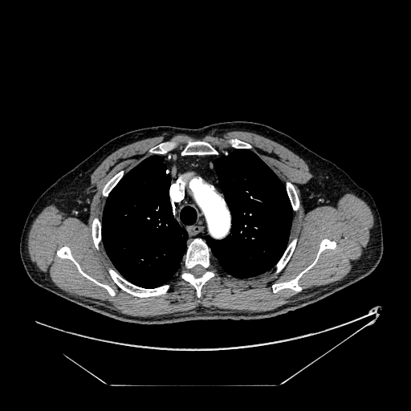
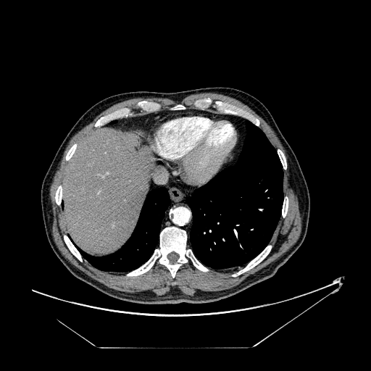
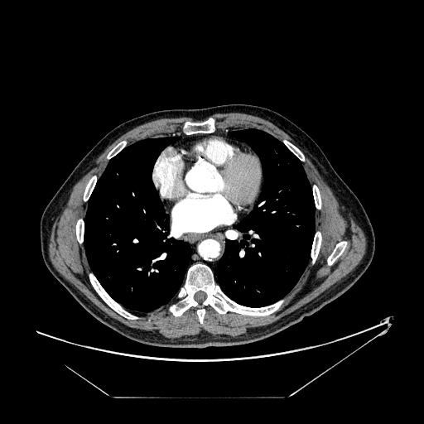
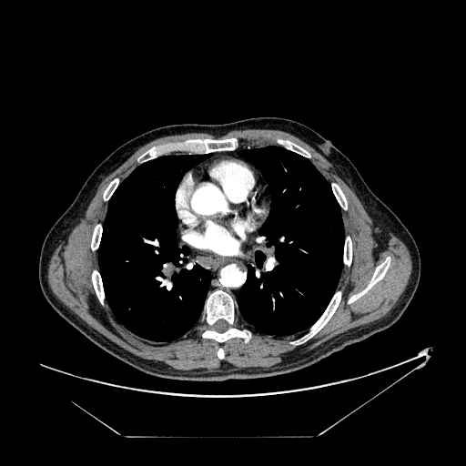
Lungs Segmentation
We used following 4 ct images to segment lungs:

Slide 3
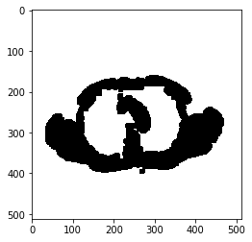
Proposed algorithm for Segmentation
To take things simple, idea was basic:
Threshold input image using otsu thresholding as mask and refine it with morphology.
There was issue with above approach as you can see in below image. The background and ROI has same color which is white.
Same issue was occuring in almost all the segmentation techniques K means etc.

Slide 4
Experimented Solutions
1) We tried to change the background color manually (using loops to set each pixel color). But this solution did not work well as some small black portions existed and it wasn’t generic.
2) We used contours and this solution also did not work well. As we got a couple of more issues.

Slide 5
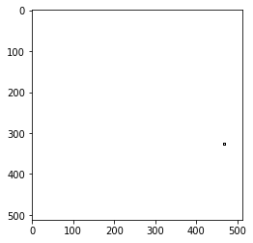
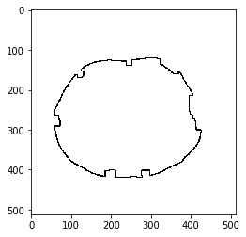
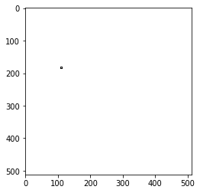
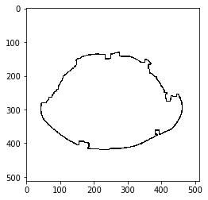
Issues using contour
For all the images, we can’t identify genarically that which contour number has lungs. Or even if any contour has both the lungs in it or not.

Slide 6
Final Algorithm
1) Threshold input image using otsu thresholding as mask and refine it with morphology opperations i.e Opening and clossing.
2) Find the contours
3) Find the biggest contour from contours that was same in all the images and draw it with white color and save it as a image.
4)Take the complement of mask that was the result of step 1.
5) And then take the bitwise-and of the complement and biggest contour that give us final mask.
6) Finally we take the bitwise-and of final mask and gray image that give final segmented lungs.

Slide 7
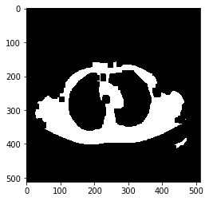
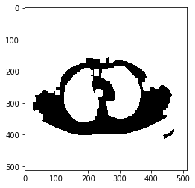
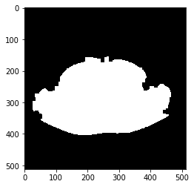
Ct image 1

Slide 8
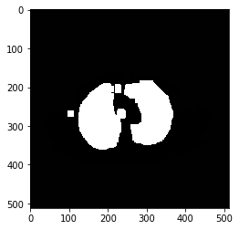
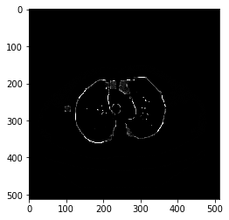
Ct image 1 cont.

Slide 9
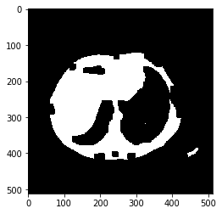
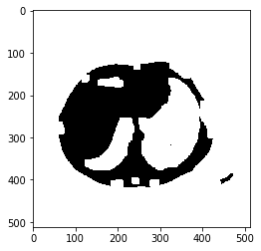
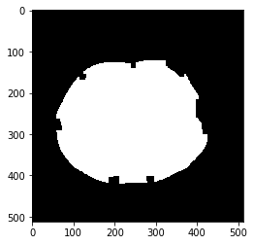
Ct image 2

Slide 10
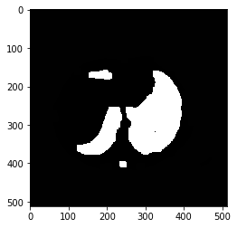
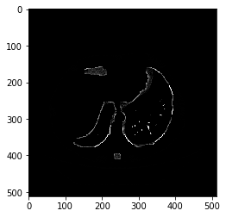
Ct image 2 cont.

Slide 11
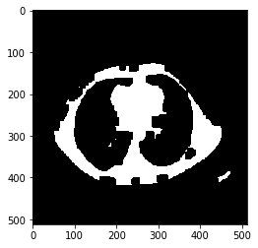
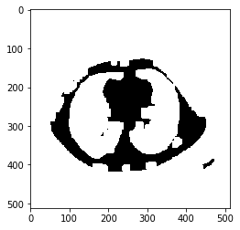
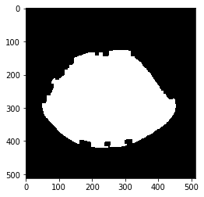
Ct image 3

Slide 12
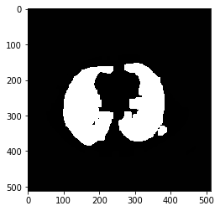

Ct image 3 cont.

Slide 13
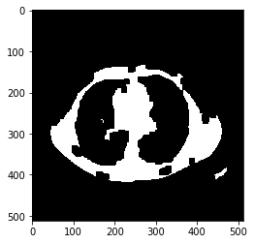
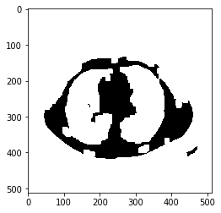
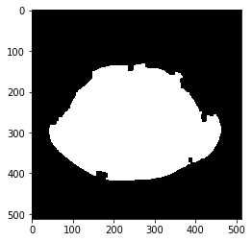
Ct image 4

Slide 14
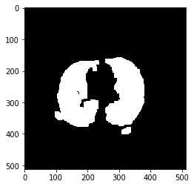

Ct image 4 cont.

